Slide 1
Title : MULTI MODEL BASED DISEASE PREDICTION SYSTEM USING MACHINE LEARNING
Disha P.U. (4MW21AD015)
Hithashree (4MW21AD019)
Neha Dinesh Shettigar (4MW21AD030)
Nidhi Prabhu K (4MW21AD032)
Guide : Dr. Ganesha Prasad
Assistant Professor(Selection Grade)
Dept : Artificial Intelligence and Data Science

Slide 2

Contents
Abstract
Introduction
Relevance of the Work
Literature Review
i. Problem Statement
ii. Objectives
Methodology
Result
Conclusion
Future scope
References

Slide 3

1. ABSTRACT
This project is a machine learning-based application designed to predict various diseases, including diabetes, heart disease, liver disease, lung disease, kidney disease, pneumonia, and other conditions based on symptoms. Using Streamlit as the front-end framework, the system provides an interactive and user-friendly interface where users can input relevant medical data or symptoms. The model then processes this data and delivers predictive insights, helping in early diagnosis and awareness. The system leverages machine learning algorithms to enhance accuracy and efficiency, offering a scalable and accessible solution for preliminary disease assessment.

Slide 4
MISSION
VISION
To help out the poor and helpless people with the normal medical checkup
To extend the role of the technology in the medical field

Slide 5

Any disease that we can take precaution is preventable.

Slide 6
2. INTRODUCTION
i. RELEVANCE OF THE WORK:
The application of machine learning (ML) in healthcare is highly relevant due to the increasing volume of medical data and the need for efficient data analysis.
Many diseases progress silently without noticeable symptoms in early stages. The proposed system helps in early detection based on patient input, allowing timely medical intervention.
AI-powered models can analyze patterns in medical data more efficiently than traditional methods. The system uses predictive algorithms to analyze health parameters and provide quick, accurate predictions.
By utilizing machine learning and Streamlit, the system contributes to better healthcare outcomes, reduced costs, and a proactive approach to disease management.

Slide 7

ii. ISSUES AND CHALLENGES
Traditional disease diagnosis often relies on individual expertise and limited patient data, leading to inconsistent diagnoses and delayed treatment.
Manual processes can be time-consuming and struggle with the complexity of multiple diseases.
Medical datasets may be incomplete, inconsistent, or imbalanced, leading to biased predictions. High-quality, large-scale datasets are often restricted due to privacy laws.
Deploying on cloud platforms (AWS, Azure) involves cost, infrastructure setup, and maintenance.

Slide 8
3. LITERATURE REVIEW
Author | Year | Focus | Method | Key findings
Khan et al. | 2018 | Model for predicting diabetes and heart disease | SVM, Random forest and logistic regression | Comparative analysis. Random forest showed high accuracy but lacked interpretability
Zhang et al. | 2020 | Comparison of machine learning models for disease prediction | Decision tree, Random forest, SVM | Using ensemble learning with interpretable models (e.g., logistic regression combined with decision trees)
Sharma and Guleria | 2023 | Comparison of deep learning models with traditional ml methods for disease prediction | CNNs (ResNet and DenseNet) | Performed well in feature extraction. High accuracy but prone to overfitting and poor generalization
Sharma et al. | 2020 | Platform for real time input and instant predictions | Streamlit | Real time predictions with easy-to-use interface.

Slide 9

i. PROBLEM STATEMENT
The Healthcare industry faces significant challenges due to the increasing number of diseases. A comprehensive solution must be developed using machine learning system that utilizes multiple models to accurately predict the presence of various chronic diseases based on patient data including diagnostic information and x-ray images.

Slide 10
ii. OBJECTIVES
To develop robust machine learning models in order to predict the likelihood of multiple diseases.
To evaluate and compare the performance of different machine learning models in predicting multiple diseases.
To implement data visualization tools that effectively highlight the relationships and distributions of key features associated with each disease.
To create an intuitive and accessible web application that allows users to input their medical data and receive instant predictions easily.

Slide 11
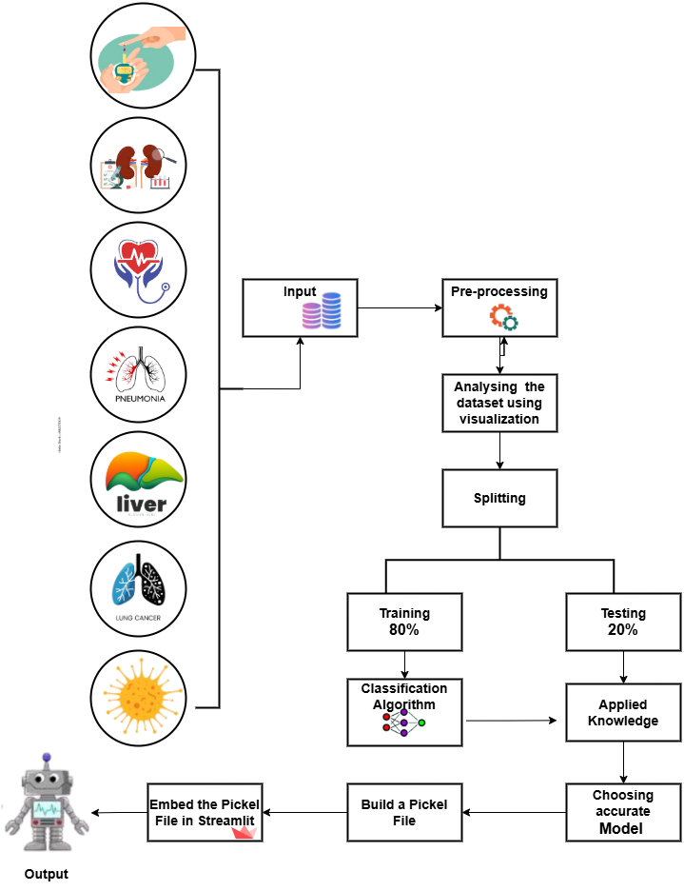
4.OVERVIEW OF METHODOLOGY

Slide 12
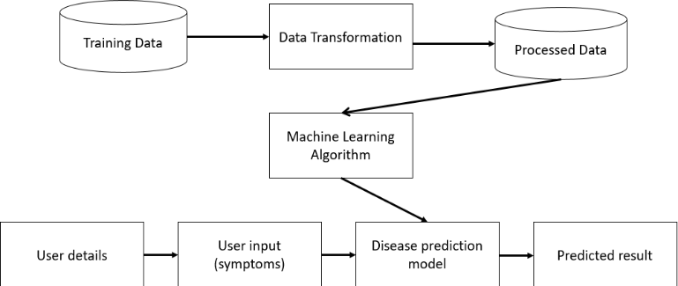
4. OVERVIEW OF METHODOLOGY

Slide 13
1 | Data Collection | Collect data from various sources, including structured data (CSV files) and unstructured data (images for CNN).
2 | Data Pre-processing | Clean and process the data (handle missing values, normalize, etc.).
3 | Feature Engineering | Select key features or transform data for better learning by the models.
4 | Model Selection | Choose appropriate algorithms (SVM, CNN, Logistic Regression, etc.).
5 | Training | Train the models using the training dataset and tune hyper parameters.
6 | Testing | Evaluate the model's performance using a test dataset with metrics like accuracy.
7 | Prediction Output | Use the trained models to predict diseases based on user input data.

Slide 14
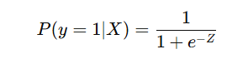
Disease-Specific Models and Techniques
a) Logistic Regression for Heart, chronic kidney, lung cancer prediction
Mathematical Foundation:
Uses a sigmoid function to convert input features (e.g., cholesterol, blood pressure) into probabilities.
Formula:
where Z is the weighted sum of features.
Prediction Process:
If P ≥ 0.5, the patient is predicted to have the disease (Class = 1).
If P < 0.5, the patient is predicted to be healthy (Class = 0).

Slide 15
b) Stacking classifier for Liver Disease prediction
Concept:
Combines multiple models (Logistic Regression & SVM) using a Random Forest as a meta-model.
Improves accuracy by merging strengths of different models.
Training Process:
Base Models: Logistic Regression & SVM predict liver disease probabilities.
Meta-Model: Random Forest learns from these predictions to make the final decision.
Prediction Workflow:
Example: A patient’s health data is processed.
Logistic Regression predicts 0.65, SVM predicts 0.72.
Random Forest combines them to predict 0.76 → Liver disease detected (≥ 0.5 threshold).

Slide 16
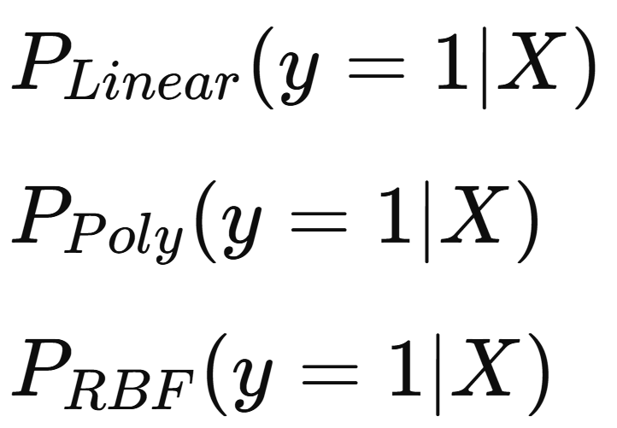
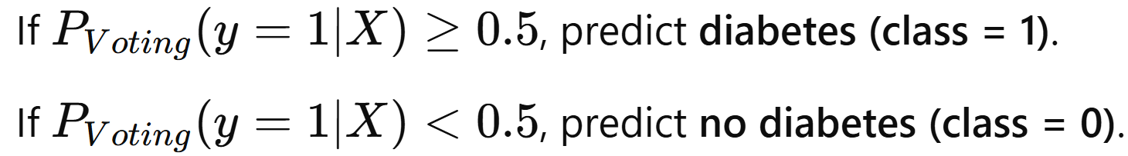
c) Voting classifier for Diabetes Prediction
Base Models Used
SVM with Linear Kernel – Works well for linearly separable data.
SVM with Polynomial Kernel – Captures more complex, non-linear patterns.
SVM with RBF Kernel – Handles highly non-linear relationships effectively.
How It Works
Each SVM model predicts a probability of diabetes:
The final prediction is made using soft voting (average probability).
Decision Rule

Slide 17
d) CNN for pneumonia prediction
Convolutional Layers – Extracts features like edges, textures, and shapes.
Pooling Layers – Reduces dimensions while keeping essential features.
Fully Connected Layers – Combines extracted features for classification.
Softmax Output – Predicts the probability of pneumonia.
How It Works
Input: Chest X-ray images are fed into the model.
Feature Extraction: Convolutional layers detect pneumonia-related patterns.
Pooling: Reduces image size while preserving key features.
Classification: Fully connected layers + Softmax function predict pneumonia.
Decision Rule
If P(y=1 | X) ≥ 0.5, predicts pneumonia (class = 1).
If P(y=1 | X) < 0.5, predicts no pneumonia (class = 0).

Slide 18
e) Symptoms based disease prediction using XGBoost
XGBoost (Extreme Gradient Boosting) is a powerful machine learning algorithm that improves prediction accuracy by combining multiple decision trees. It is widely used in medical diagnosis.
Data Collection – Gather symptoms, medical history, and test results.
Preprocessing – Encode categorical data, normalize values, and remove missing data.
Model Training – XGBoost builds multiple decision trees sequentially.
Prediction – The model outputs a probability score for disease presence.
Classification – If probability ≥ 0.5, disease is predicted; otherwise, no disease.
Example Scenario
Input: Patient reports symptoms like fever, fatigue, and cough.
Processing: XGBoost analyzes these symptoms based on past data.
Output: Probability of disease = 0.82.
Decision: Since 0.82 > 0.5, the model predicts disease presence.

Slide 19
Logistic Regression :It works by modeling the relationship between the symptoms (independent variables) and the probability of a disease (dependent variable). Here the model uses a logistic function (sigmoid) to map predicted values to a probability between 0 and 1. If the probability exceeds a certain threshold (usually 0.5), the model predicts the presence of the disease.
Voting classifier :The Voting Classifier is an ensemble learning technique that combines predictions from multiple models to improve accuracy and robustness. It uses either hard voting (majority class wins) or soft voting (average of predicted probabilities) to make the final decision.
Voting classifier for diabetes prediction combines the strengths of multiple SVM kernels (Linear, Polynomial, and RBF), leading to improved accuracy, increased robustness, better generalization and flexibility.
XGBoost :XGBoost builds multiple decision trees, where each new tree corrects the errors of the previous one. It starts with an initial prediction, calculates residuals (errors), and adds trees to improve accuracy. Regularization is used to prevent overfitting.
The final prediction is a combination of all trees' outputs, making XGBoost highly effective for complex tasks like predicting diseases based on symptoms.

Slide 20
Stacking classifier :A stacking classifier is an ensemble learning technique that combines multiple models (base learners) to make predictions. It works by training several different models on the same data and then using another model (meta-learner) to learn how to best combine the predictions of the base models to make the final prediction.
The meta-model is trained on the output of the base models, rather than the original input data. This allows stacking to capture more complex patterns and improve predictive accuracy.
Convolution Neural Network :CNNs are highly suitable for medical image analysis(pneumonia) because they can automatically extract relevant features from the images, reducing the need for manual feature engineering.

Slide 21
DISEASE PREDICTION WORKING
Data Collection
Data Preprocessing
Data Visualization
Feature Selection
Feature Scaling
Model Selection
Prediction

Slide 22
Integration with streamlit
Integrating all the machine learning models using Streamlit allows us to create a unified and interactive platform for multi-disease prediction.
By leveraging Streamlit's simplicity and flexibility, we can seamlessly connect different models, such as those for heart disease, diabetes, lung cancer, liver disease, kidney disease, pneumonia detection, and symptoms-based disease prediction, into a single web application.
This integration enables users to input relevant medical data or upload diagnostic images, with the system processing the inputs and displaying real-time predictions.
Streamlit’s intuitive interface, combined with its support for data visualization and user-friendly controls, enhances accessibility for both medical professionals and patients.
By centralizing multiple disease prediction models in one streamlined application, we improve efficiency, scalability, and ease of use, making advanced healthcare insights more readily available.

Slide 23
5. RESULTS
Disease | Best Model | Accuracy
Diabetes | Voting Classifier | 85%
Chronic Kidney | Logistic Regression | 97%
Heart Disease | Logistic Regression | 88%
Pneumonia | CNN | 87.66%
Liver Disease | Stacking Classifier | 76%
Symptoms based Prediction | XGBoost | 98%
Lung Cancer | Logistic Regression | 96%

Slide 24
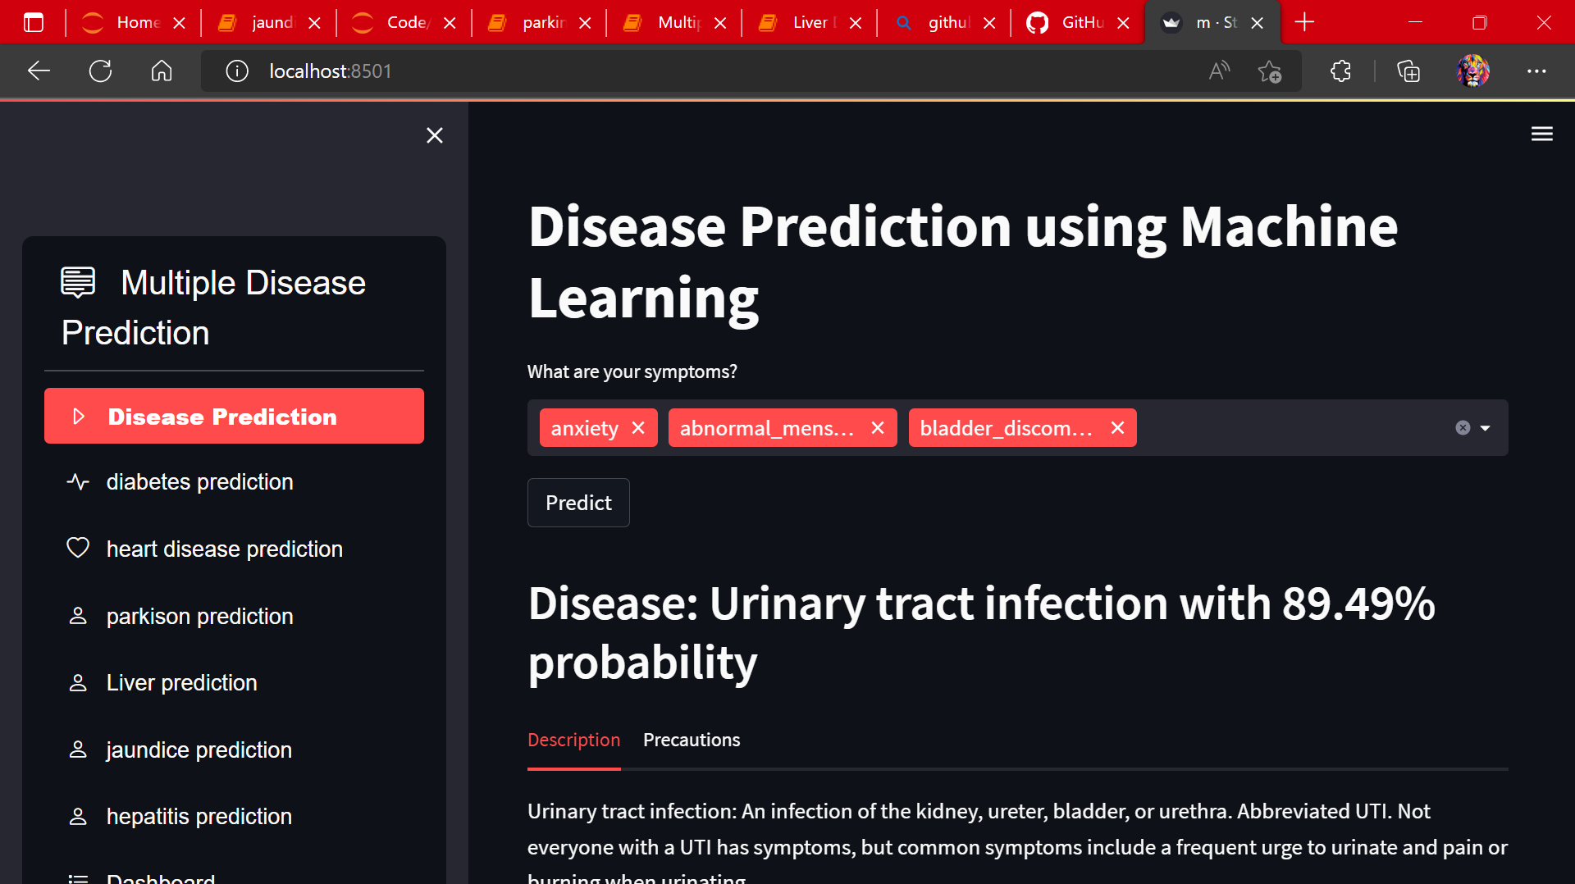

Slide 25
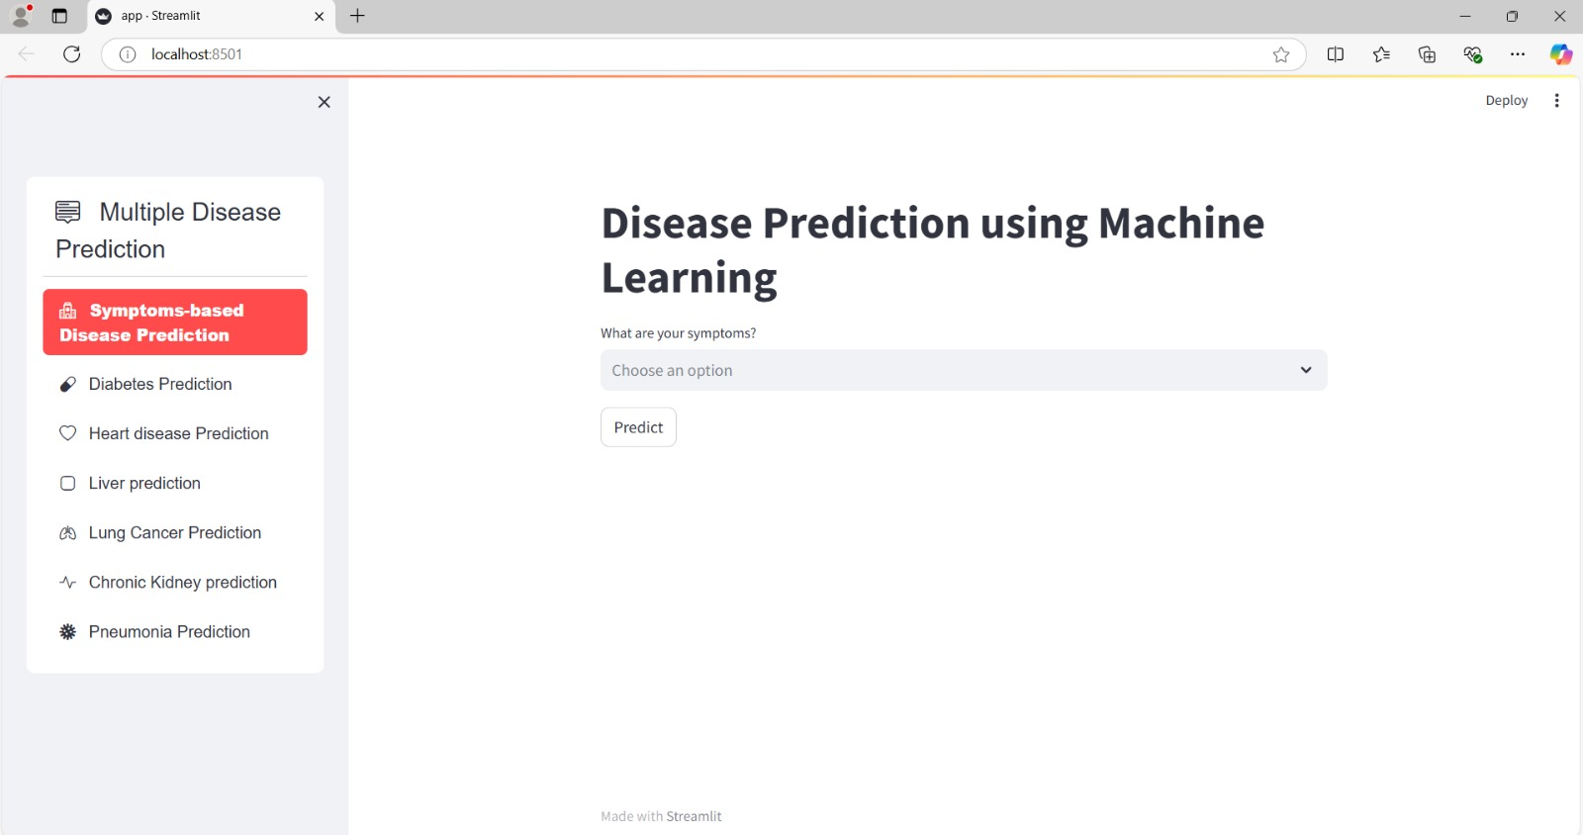

Slide 26
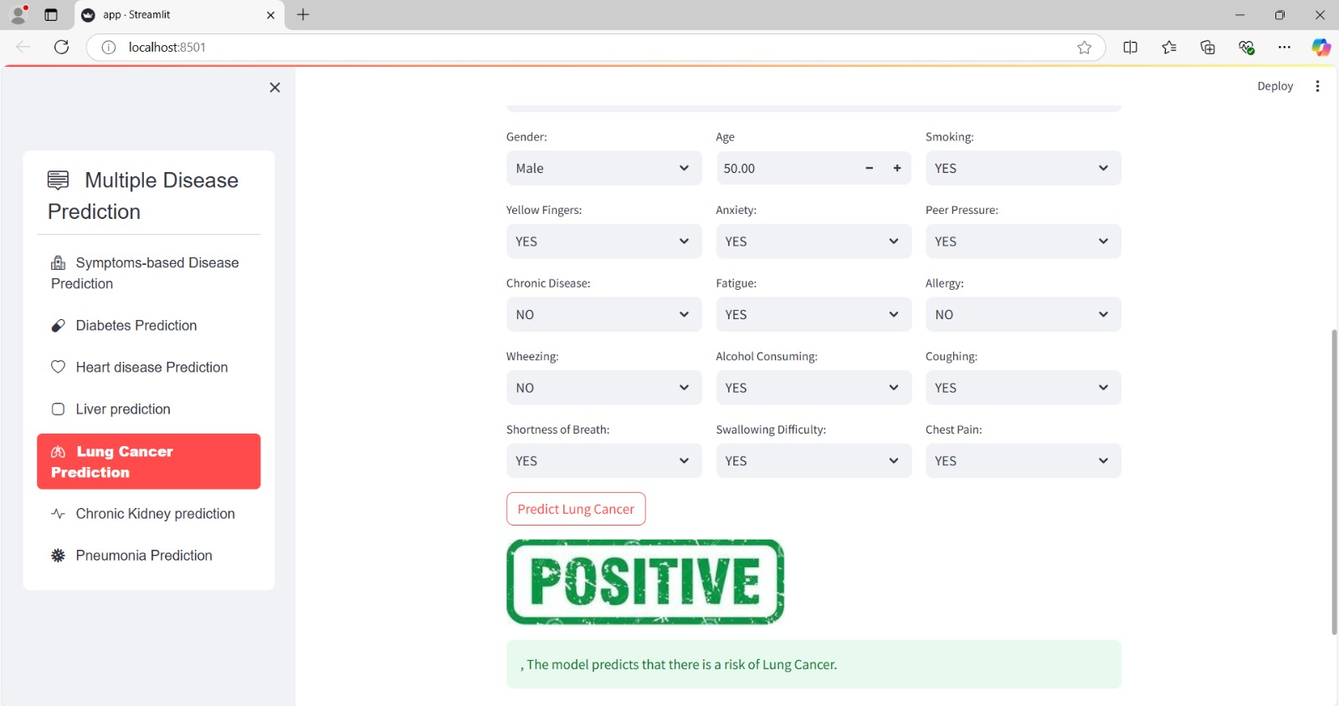

Slide 27
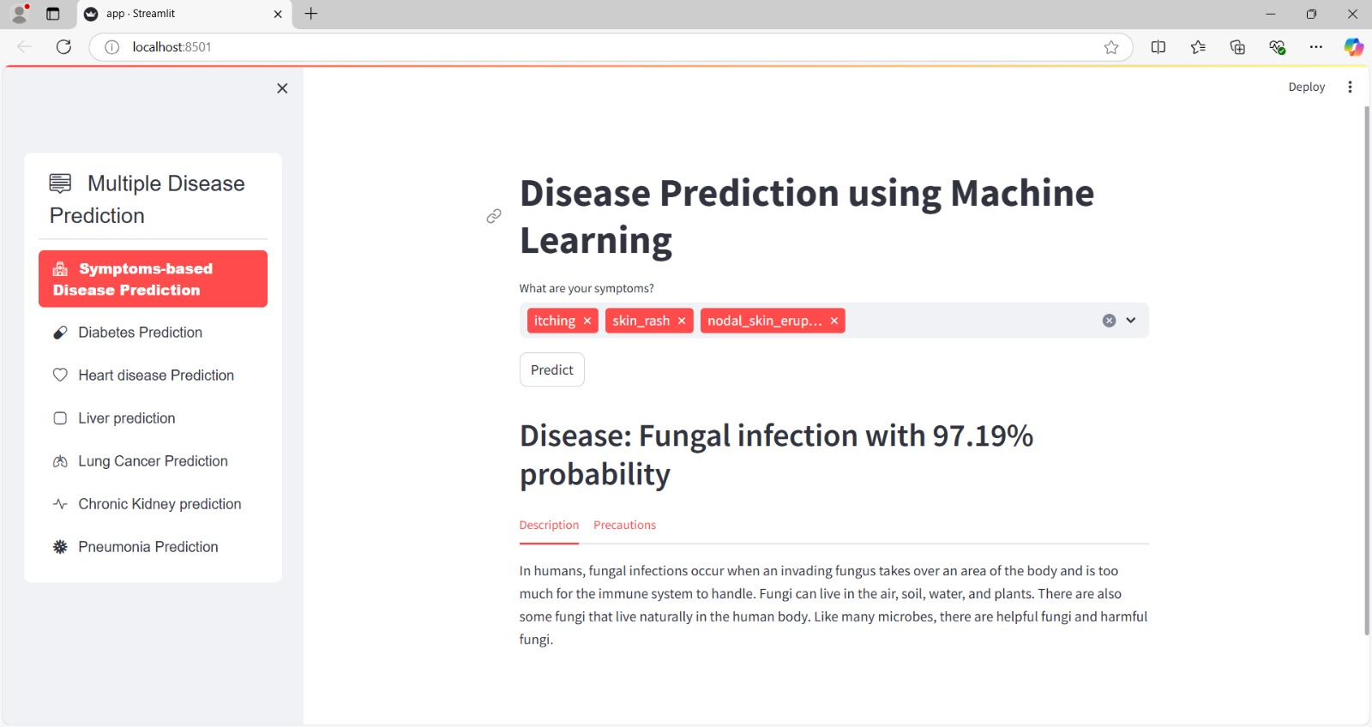

Slide 28
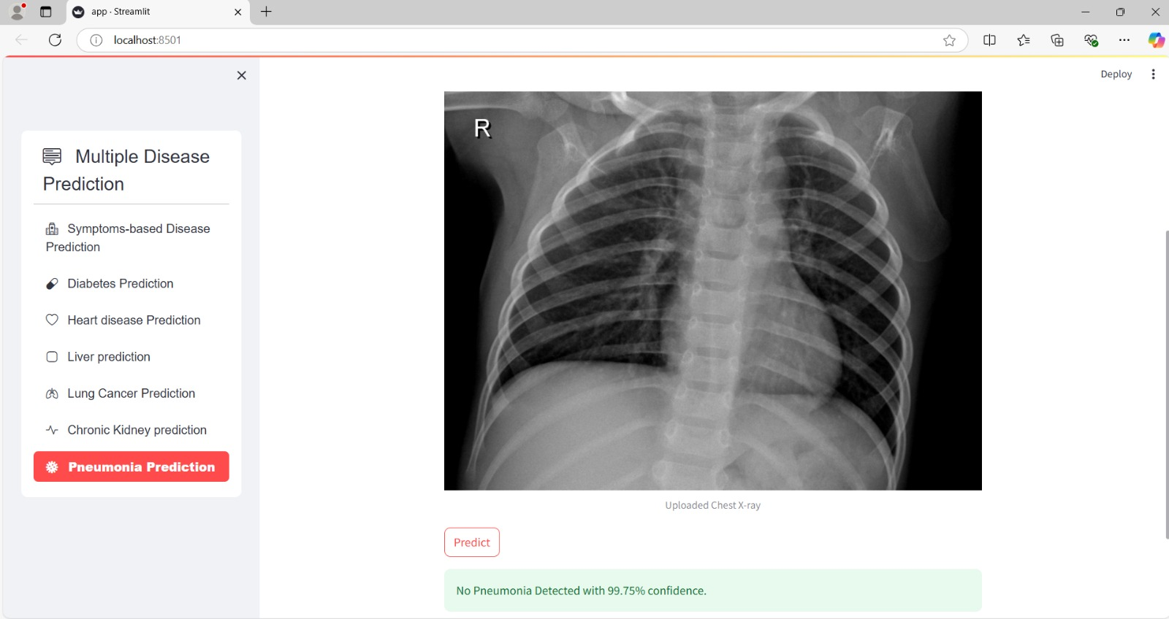

Slide 29

6. FUTURE SCOPE
Expanded Symptoms DB: Integrates diverse sources for better diagnosis of rare/overlapping conditions.
Basic Patient Management: Enables registration, history tracking, and appointment scheduling.
Wearable Integration: Real-time health data from IoT wearables for early critical alerts.
AI-Based Personalized Medicine: Tailors treatment using AI analysis of genetics and lifestyle.
Cloud Deployment: Streamlit on cloud ensures scalability, responsiveness, and availability.

Slide 30
7. CONCLUSION
The Multiple Disease Prediction System using Streamlit provides an intuitive and efficient platform for early diagnosis of various diseases, including diabetes, heart disease, liver disease, lung disease, kidney disease, and pneumonia.
By integrating symptom-based prediction, it enhances accessibility for patients and healthcare providers, offering a comprehensive, user-friendly tool for preliminary health assessments.
The system leverages machine learning for fast and accurate predictions, promoting preventive care and reducing late-stage diagnoses.
Its scalability and seamless integration into healthcare platforms make it a valuable contribution to modern medical technology.

Slide 31

OUR TEAM
Disha P U
Hithashree
Neha Dinesh shettigar
Nidhi Prabhu K

Slide 32

PROJECT REQUIREMENTS
Software USED : Python interpreter , jupyter notebook, Vs code , Any browser
Front-end USED : streamlit python library
Back-end USED : Python , NumPy Pandas, Scikit-Learn.
Database USED : sqlite3

Slide 33
8. REFERENCES
[1] Khan, A., et al. (2018). "Multi-Disease Prediction Using Support Vector Machines, Random Forests, and Logistic Regression." Journal of Healthcare Informatics, 34(2), 112-123.
[2] Zhang, L., et al. (2020). "Comparing Decision Trees, Random Forests, and Support Vector Machines for Multi-Disease Prediction." International Journal of Data Science, 45(3), 200-215.
[3] Sharma, P., & Guleria, A. (2023). "Deep Learning for Pneumonia Detection Using Chest X-Ray Images: A Review of CNN Models." Journal of Medical Imaging and Health Informatics, 13(2), 456-472.
[4] Sharma, R., et al. (2020). "Development of an Intuitive Disease Prediction Platform Using Streamlit." Healthcare Technology Letters, 7(5), 287-298.

Slide 34
THANK YOU

